Slide 1

PREDICTING CREDIT CARD DEFAULTERS
By Moaz Nabeel
ABSTRACT
Machine learning techniques can be used as an
important tool for financial risk management.
Data Science Career Track - Springboard

Slide 2
1. Introduction
The data set selected is called “Default of credit card clients Data Set” .
Predict which classification method / data mining technique that will give the best accuracy for the probability of default of credit card clients.
Client will be banks in Taiwan because banks will be utilizing the analysis and machine learning models to better understand their clientele and will be able to make decisions on their customers which will benefit them from customers that will most probably default.

Slide 3
2. Classifier set
Decision Trees
Random Forest
Logistic Regression
Ensemble Techniques Boosting
XGBoost
ADABoost
Voting Classifier
Bagging

Slide 4
3. Data Description
Age (in years);
Gender (where 1 = male and 2 = female);
Marital status (where 1 = married, 2 = single, and 3 = other);
Education (where 1 = graduate school, 2 = university, 3= high school, and 4 =other); and
Credit limit.

Slide 5
3. Data Description (CONT’D)
Past payment status that month, where:
-2 = no consumption;
-1 = paid in full;
0 = the use of revolving credit;
1 = payment delay for one month;
2 = payment delay for two months;
…;
8 = payment delay for eight months;
9 = payment delay for nine months and above;
Amount billed that month; and
Amount paid that month.

Slide 6
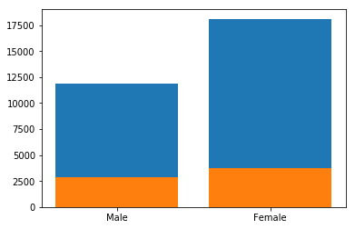
4. Statistical Analysis Defaulters based on Gender
Proportion of male defaulters is 24.16 %
Proportion of female defaulters is 20.77%
Total number of males in data was 11888 and total number of females in data was 18112.

Slide 7
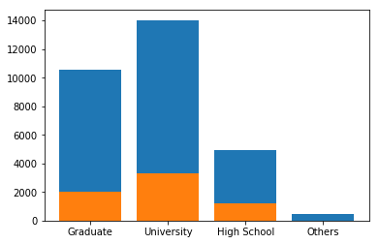
4. Statistical Analysis (CONT’D) Defaulters based on Education Level
University level with 23.74%
High School level with 23.45%
Graduate level with 19.24%
Others with 5.7%

Slide 8
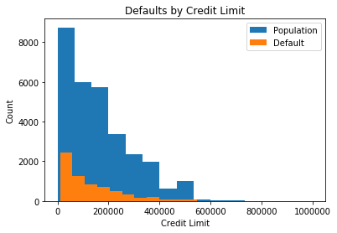
4. Statistical Analysis (CONT’D) Defaulters based on Credit Limit
From 0 limit balance to 200000: 25.34%
from 200000 limit balance to 400000: 15.48%
from 400000 limit balance to 600000: 12.28%
from 600000 limit balance to 800000: 7.69%

Slide 9
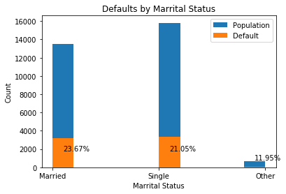
4. Statistical Analysis (CONT’D) Defaulters based on Gender
Married with 23.67%
Single with 21.05%
Others with 11.95%

Slide 10
5. Feature Engineering
Feature 1:
Addition of first three payments names PAY_0, PAY_2 and PAY_3.
Feature 2:
Using above three payments and making a binary column if any of the three above payments had -2 or +2.
Feature 3:
Sixth month payment minus the sixth month bill amount.
Feature 4:
First month payment minus the first month bill amount.

Slide 11
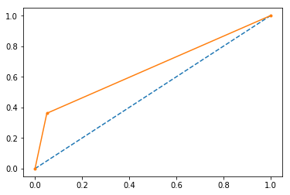
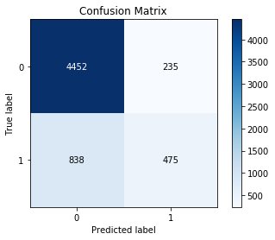
5. Machine Learning Results Decision Trees
Decision tree structure is composed of nodes and leaves
Root node is the top-most node in the tree
Decision tree result in simple classification rules and handle nonlinear and interactive explanatory variables
It scored ROC-AUC score of 0.6558
Test Accuracy Score : 82.11%

Slide 12
5. Machine Learning Results Random Forest
An ensemble learning method for:
Classification
Regression
Miscellaneous
Operates by:
constructing a multitude of decision trees
training time and
outputting the class that is the mode of the classes (classification) or mean prediction (regression)
‘GINI’ criterion was used with 4 jobs and 400 estimators
Test Accuracy Score : 82.08%

Slide 13
5. Machine Learning Results Logistic Regression
Used in:
Credit Risk Modeling
Financial Prediction
Operates by:
Studies association in categorical dependent variable and set of independent variables
Produces a probabilistic formula of classification
Deal with non-linear effects of explanatory variables
Parameters:
penalty=‘12’, dual=False, max_iter=145, C=2, fit_intercept=False
A test set score was 78.11%.

Slide 14
5. Machine Learning Results XGBoost and ADABoost
Ensemble learning method to decrease variance in bias
Boosting is a machine learning meta-algorithm
Converts weak learners to strong ones
A weak learner is defined to be a classifier that is only slightly correlated with the true classification
Test accuracy score of XGBoost : 82.02%
After feature engineering XGBoost : 82%
Test accuracy score of ADABoost : 81.93%

Slide 15
5. Machine Learning Results Ensemble and Bagging
An ensemble learning method for:
decrease variance (bagging)
bias (boosting)
improve predictions (stacking)
Bootstrap Aggregation(Bagging):
reduce the variance for those algorithms that have high variance
classification and regression trees (CART)
Bagging is the application of the Bootstrap procedure to a high-variance machine learning algorithm, typically decision trees
Ensemble’s voting classifier chose XGBoost with default parameters as the best Classifier with Test Accuracy of 81.8%
Bagging with Random Forest achieves test accuracy of 81.95%
Bagging with Decision Tree achieves test accuracy of 81.53%

Slide 16
5. Machine Learning Results All Results

Slide 17
Thank You!
By Moaz Nabeel

